Slide 1
Lecture 3 seismic waves

Slide 2
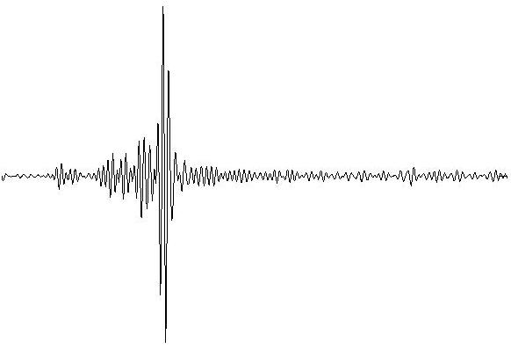
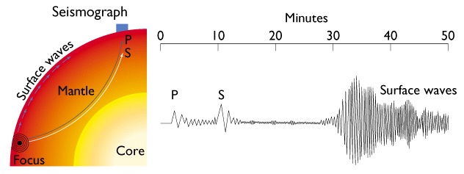
Seismic waves inside the Earth
How does earthquake energy travel through the Earth's interior ?

Slide 3
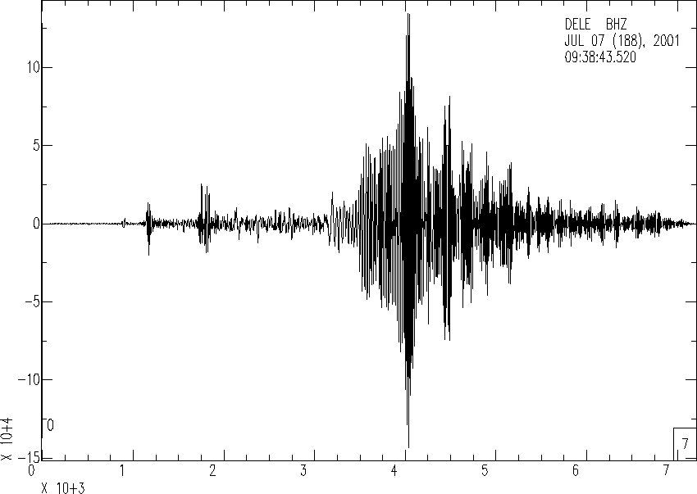
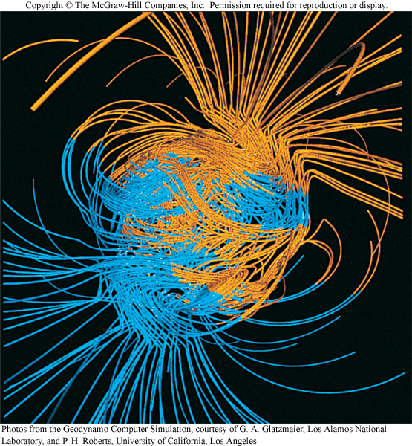
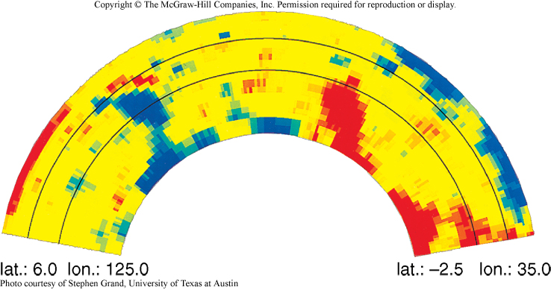
Indirect Study of the Earth's Interior - Geophysics
- Seismic Waves
- Gravity
- Heat Flow
- Magnetic Field

Slide 4
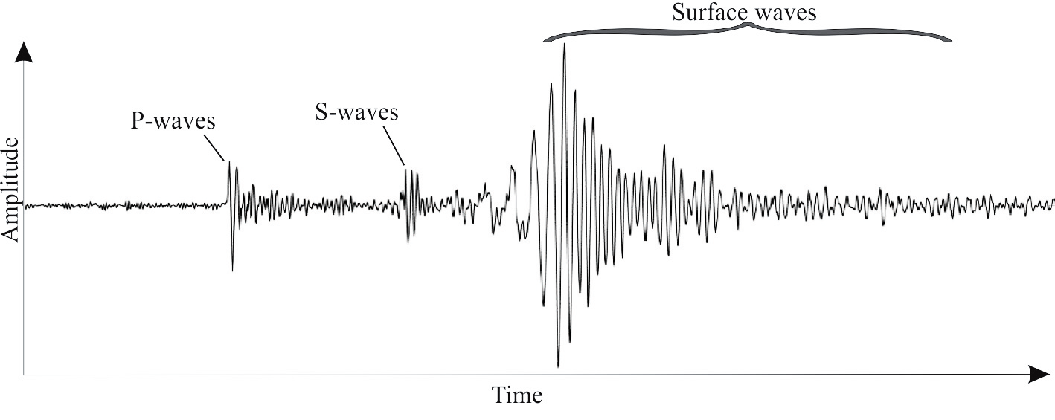
Seismic Waves Body Waves Primary Waves (P-Waves) => VP ~5-7 km/s Secondary Waves (S-Waves) => VS ~3-4 km/s Surface Waves Love Waves (L-Waves) => VL ~2.0-4.4 km/s Rayleigh Waves (R-Waves) => VR ~2.0-4.2 km/s

Slide 5
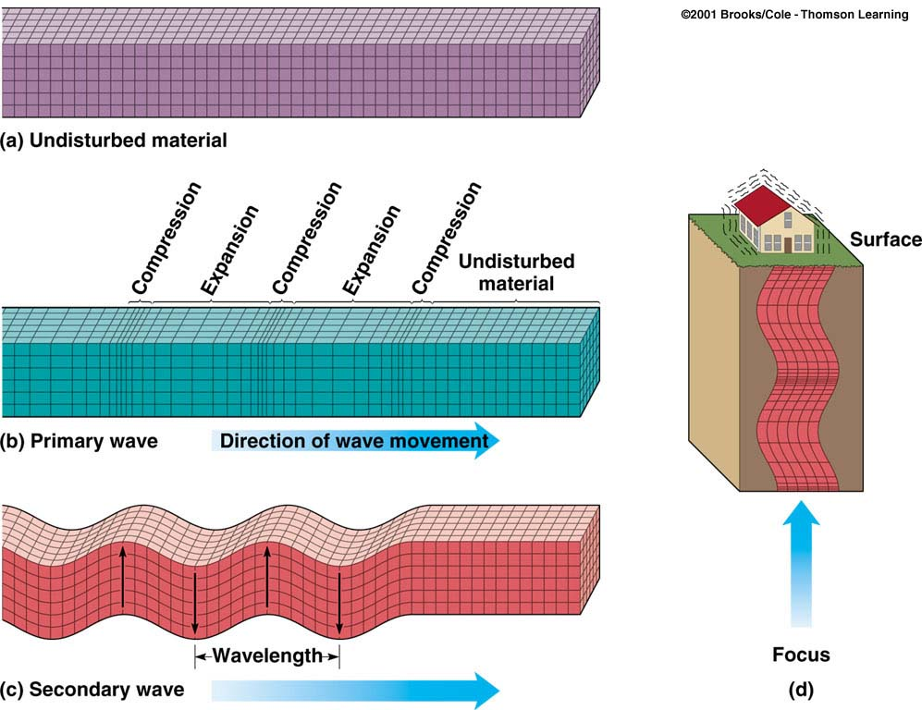
Body Waves: P and S waves
Body waves
P or primary waves
fastest waves
travel through solids, liquids, or gases
compressional wave, material movement is in the same direction as wave movement
S or secondary waves
slower than P waves
travel through solids only
shear waves - move material perpendicular to wave movement

